Slide 1





Needfinding
CS 147: Assignment #1
Alison Rogers, Justin Blumencranz, Monica Hicks, Matthew Mattei

Slide 2

Roadmap
Introduction
Team; Problem Domain
Methodology
Participants; Questions
Results
Quotes; Surprises
Analysis
Empathy Maps; Insights
Notes:
Introduction:
Introduce the team
Discuss our problem domain
Methodology:
Introduce our participants
the questions we asked
Results:
Share some quotes from our interviews
Some surprises we uncovered
Analysis:
Empathy reveal our empathy maps
Insights from the interviews

Slide 3

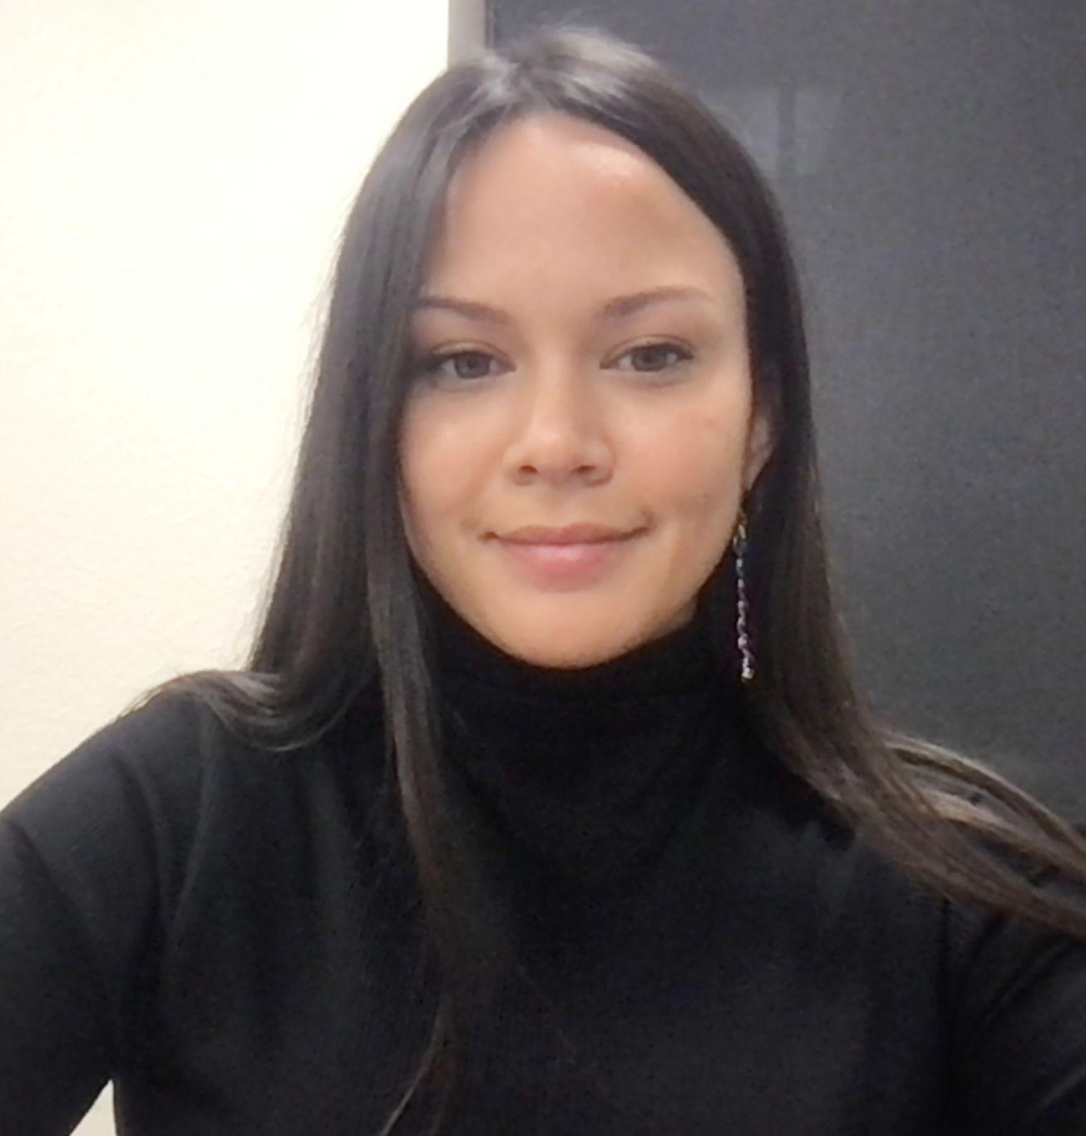
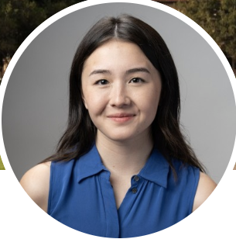


Meet the Team!
Matthew Mattei
Junior; Computer Science
Monica Hicks
Coterm; Computer Science
Alison Rogers
Coterm; Computer Science
Justin Blumencranz
Senior; Symbolic Systems
Introduction
Methodology
Results
Analysis
Notes:
I introduce everyone
We’re all upperclassmen in computer science or symbolic systems
All 4 of us have been section leaders for CS 106A and CS 106B

Slide 4
Our chosen problem domain is…
High School
Reason 1
Large and relatable problem space
Reason 2
Garnered team interest
Reason 3
Significant opportunity for impact
Notes:
Reason 1:
There are over millions of high schoolers across the united states.
We’ve all been in high school before, but the landscape has likely changed since we graduated
Reason 2:
We’re all very passionate about bettering early education, as we’ve all are or have been section leaders
Reason 3:
Kids will spend 4 years of their life in high school. It’s a population we want to support as best we can.
Proposed reasons:
There will likely always be high school students (continuing market)
There is a lot of pressure to get into good colleges, so there is high motivation to perform well in HS

Slide 5
Methodology
4 Interviews
1 Online and 3 In Person
Compensation: ~$20 in various forms (gift card, Venmo, food, etc.)
Recruitment: parent reach outs, cold approaches
Introduction
Methodology
Results
Analysis

Slide 6
June
Why we chose them?
High school student we had easy access to
(we were able to cold-approach them)
Why were they appropriate?
Currently in high school
Only student we interviewed from a private high school
What did we ask/talk about?
Balancing school and sports, study methods, school culture, school-provided support services, post-HS plans, what motivates them to do well in school
Stanford Shopping Mall
Where:
iPhone Audio
Apparatus:
Alison, Monica
Interviewers:
Justin
Notetaker:
Introduction
Methodology
Results
Analysis

Slide 7
Extreme User
Anwar
Zoom
Why we chose them?
We were seeking a student who doesn’t go to a traditional high school.
Why were they appropriate?
Non-traditional high school
They don’t plan on attending college
What did we ask/talk about?
Self-managing their schedule
Learning strategies in and out of the classroom
Who they turn to for support in a remote environment
Post-HS plans other than college
Where:
Zoom Recording
Apparatus:
Monica, Matthew
Interviewer(s):
Matthew
Notetaker:
Online High School
Extreme Axis:
Introduction
Methodology
Results
Analysis

Slide 8
Sasha
Why we chose them?
High school student we had easy access to
(we were able to cold-approach them)
Why were they appropriate?
Attends public high school
Juggles being a student and working
What did we ask/talk about?
Studying and note taking techniques
Applying to high schools and pre-college programs
Feeling unsafe in school (fighting, drugs, guns)
Seeking outside help (finding/scheduling tutors)
Stanford Shopping Mall
Where:
iPhone Audio
Apparatus:
Alison, Monica
Interviewers:
Justin
Notetaker:
Introduction
Methodology
Results
Analysis
Notes:
Chosen?
Easy access via cold approach
Appropriate Attends public high school
Juggles being a student and working

Slide 9
Jerry
Why we chose them?
High school student who goes to Paly. We were able to get in touch with his parent by reaching out to community members.
Why were they appropriate?
Has ADHD and dysgraphia.
Involved in the college recruitment process.
What did we ask/talk about?
Adapting to high school with ADHD
Schoolwork management techniques
Being a student athlete
Town and Country
Where:
iPhone Audio
Apparatus:
Alison
Interviewer(s):
Matthew
Notetaker:
Introduction
Methodology
Results
Analysis
Notes:
Goes to public high school “Palo Alto High School”
Reached out through his parents we knew
Has ADHD and dysgraphia
Actively applying to colleges

Slide 10

Some of our questions…
How does your school day unfold?
How do you identify when you are “stuck”?
What resources does your school have for students?
How do you keep track of assignments?
What motivates you to do well in school?
Have you thought about what your life will look like after high school?

Slide 11
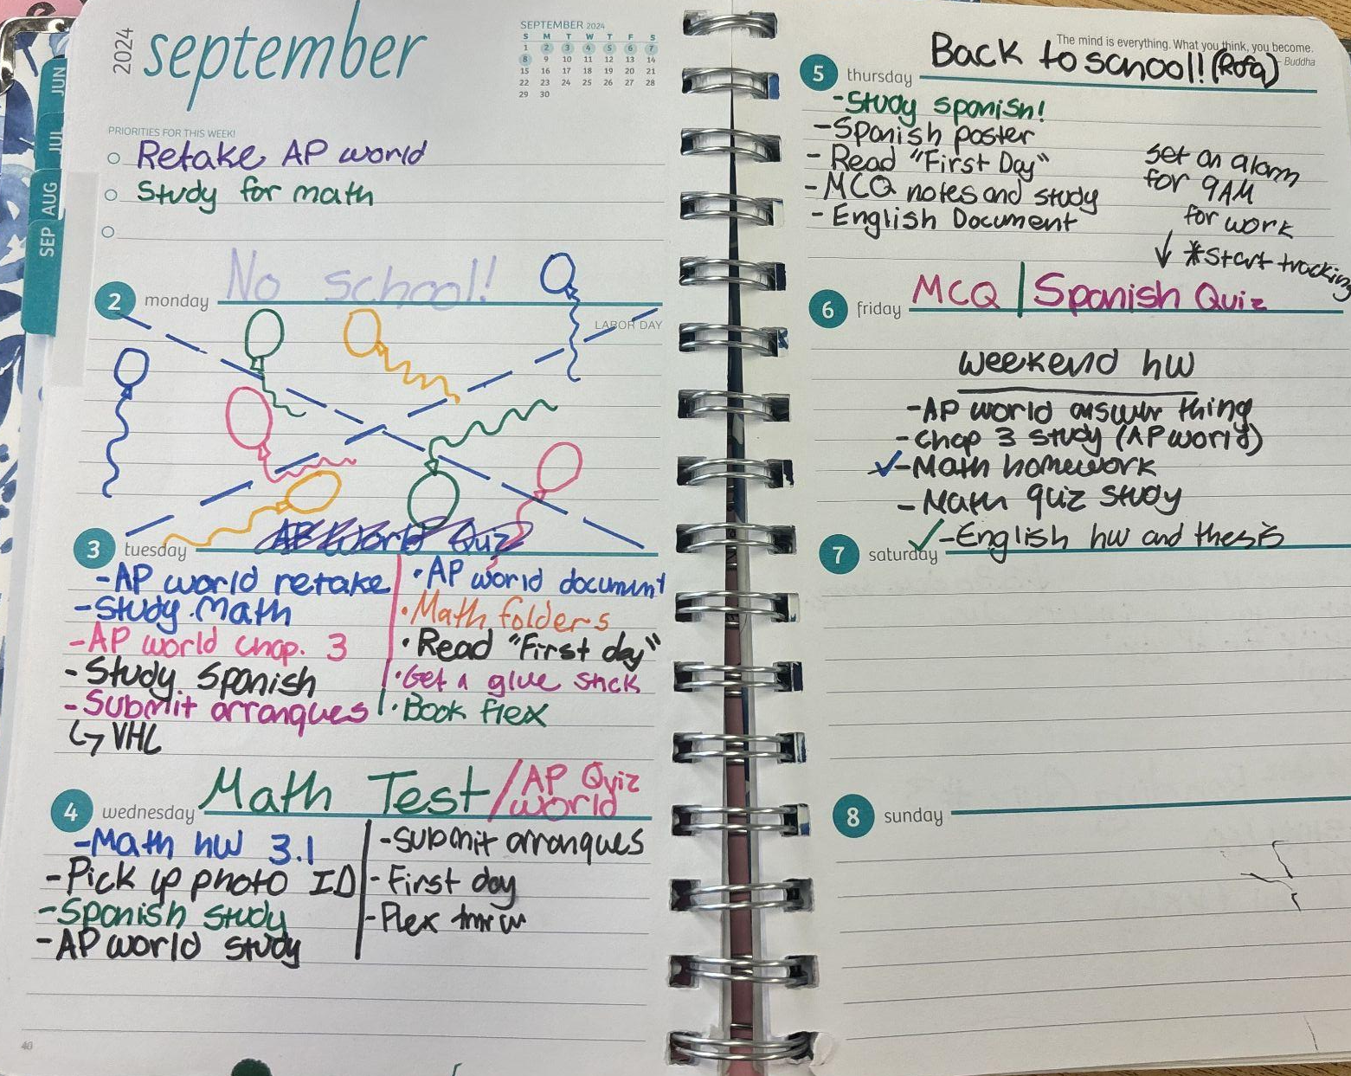
Introduction
Methodology
Results
Analysis

Slide 12
Key Quotes and Surprises
“[How long I want to continue diving for] a big question in my life right now, I’ve recently not found the joy I’ve had in the past, so it’s big a real mental dilemma for me if I want to continue because a lot of people think quite highly on me and depend on me for points and the sport so it's hard for me to decide if it's best for me and I would only do recruitment if it was for a school I was super passionate and it was the only way to get in.”
-Jerry
Introduction
Methodology
Results
Analysis

Slide 13
Key Quotes and Surprises
Tension
Surprise
Contradiction
Despite high school taking up most of their time, most interviewees prefer their extracurriculars
A student overdosed at school last year. Fights and fire alarm pulling happen weekly.
Applied to Menlo High School, but promised parents they wouldn’t go if they were admitted.
Introduction
Methodology
Results
Analysis

Slide 14
Empathy Map for Sasha
“Not all teachers post their assignments on Canvas.”
Think
Athletics are motivating
Say
She has lots of tutors, “I’m not academically challenged, I’m just devoted.”
It is more important to build a resume than to have fun
On her school’s “Life Skills” curriculum: “it’s a solid curriculum…in the perfect world…but, like, the guy behind me in ethnic studies was vaping on me.”
Coaching volleyball is less work than playing. “I’m making bank and I have something to put on a resume.”
It’s all on her to manage her assignments
School- provided support is not effective
“Math is really hard for me.”
College is a high priority
Wants to study English
“As soon as I hear an assignment, I write it down…it might be the only time I hear it.”
Her school has fights, and the fire alarm gets pulled 2+ times/week
Getting rid of AP is only for equity reasons
School has two populations: “honors” and “riff raff”
Things are easy to remember if she has a “trick”
Motivation: “Getting into college.”
“I don’t eat lunch”, does homework instead and drinks coffee
She can’t get into an elite high school
Peer tutors are not helpful
She has an immigrant parent
Observation -> Inference
Takes pretty notes in her planner
Stressed about missing an announcement in class
Proud of her school/life system
Goes home whenever she can instead of staying on campus
Unnoticed in larger classrooms
Chose to interview with us instead of coaching volleyball practice (used a freebee)
Does extra schoolwork
Not confident in her ability to be a college athlete
Doubtful of her school’s equity efforts (misguided)
Applied to summer college programs
Always uses flashcards
Scared and unsafe at her high school
Worried about reliability of physical notes
Emphasized “Stanford” when calling her dad
Underprepared for the transition to high school
Applied to Menlo to get application practice
Uses a writing tutor as a second teacher
Feel
More comfortable sending kids to private school
Wakes up at 7am
Strong desire to get into a good college
Do

Slide 15
Empathy Map for Sasha
“Not all teachers post their assignments on Canvas.”
Think
Athletics are motivating
Say
She has lots of tutors, “I’m not academically challenged, I’m just devoted.”
It is more important to build a resume than to have fun
On her school’s “Life Skills” curriculum: “it’s a solid curriculum…in the perfect world…but, like, the guy behind me in ethnic studies was vaping on me.”
Coaching volleyball is less work than playing. “I’m making bank and I have something to put on a resume.”
It’s all on her to manage her assignments
School- provided support is not effective
“Math is really hard for me.”
College is a high priority
Wants to study English
“As soon as I hear an assignment, I write it down…it might be the only time I hear it.”
Her school has fights, and the fire alarm gets pulled 2+ times/week
Getting rid of AP is only for equity reasons
School has two populations: “honors” and “riff raff”
Things are easy to remember if she has a “trick”
Motivation: “Getting into college.”
“I don’t eat lunch”, does homework instead and drinks coffee
She can’t get into an elite high school
Peer tutors are not helpful
She has an immigrant parent
Observation -> Inference
Takes pretty notes in her planner
Stressed about missing an announcement in class
Proud of her school/life system
Goes home whenever she can instead of staying on campus
Unnoticed in larger classrooms
Chose to interview with us instead of coaching volleyball practice (used a freebee)
Does extra schoolwork
Not confident in her ability to be a college athlete
Doubtful of her school’s equity efforts (misguided)
Applied to summer college programs
Always uses flashcards
Scared and unsafe at her high school
Worried about reliability of physical notes
Emphasized “Stanford” when calling her dad
Underprepared for the transition to high school
Applied to Menlo to get application practice
Uses a writing tutor as a second teacher
Feel
More comfortable sending kids to private school
Wakes up at 7am
Strong desire to get into a good college
Do

Slide 16
Empathy Map for Anwar
School is a means to an end but not enjoyable
Think
Say
Goal: a job
“I was having trouble with a lot of people in the school and a lot of people out of school, and it got brought into school.”
“I have uncles/aunts that went or didn’t, and if they did go to college, they went late.”
He would explore things outside high school if he could
He was left out of the decision to do online school
He has to earn his way back into in-person school
Virtual school times are weird, but not having to commute is great
“I don’t really want to go to college, but my mom and dad said that if whatever I want to do takes me to college, I have to go to college.”
“I don’t talk to anyone about [learning material]”
Sometimes studying works and sometimes it doesn’t
“I don’t remember things pretty often…I still try to do it.”
Planning ahead for things that might not happen is a waste of time
“I need to keep my grades up…so that they can accept my transfer back”
College may or may not be the right path for him
“I can’t fully get into tattoo school yet.”
“[My mom] didn’t tell me [about online school] until a couple days before school.”
Videos are the best method of instruction
Support is for moments of struggle
Family in trade jobs
Observation -> Inference
Writes down class times and sets alarms
Is emailing to get back to in-person school
Eager to be back in person
Supported by his parents in whatever he decides to do after high school
Socially isolated
Gets extra practice problems from his teacher (not a typical offering)
Motivated by failure to seek extra help
Practices tattooing
Asks his mom’s advice for most things
Confused by written instructions
Caught off guard by being enrolled in online school
Kicked out of his school for fighting
Going out with friends
Completes homeworks in the form of “TODO”s
Car washed to raise money to get more into tattooing
Calm when doing breathing exercises or listening to music
Guided by his mom
Feel
Repeatedly rereads notes to study
In-person school is tiring but more fun
Distant from friends
Do

Slide 17
Empathy Map for Anwar
School is a means to an end but not enjoyable
Think
Say
Goal: a job
“I was having trouble with a lot of people in the school and a lot of people out of school, and it got brought into school.”
“I have uncles/aunts that went or didn’t, and if they did go to college, they went late.”
He would explore things outside high school if he could
He was left out of the decision to do online school
He has to earn his way back into in-person school
Virtual school times are weird, but not having to commute is great
“I don’t really want to go to college, but my mom and dad said that if whatever I want to do takes me to college, I have to go to college.”
“I don’t talk to anyone about [learning material]”
Sometimes studying works and sometimes it doesn’t
“I don’t remember things pretty often…I still try to do it.”
Planning ahead for things that might not happen is a waste of time
“I need to keep my grades up…so that they can accept my transfer back”
College may or may not be the right path for him
“I can’t fully get into tattoo school yet.”
“[My mom] didn’t tell me [about online school] until a couple days before school.”
Videos are the best method of instruction
Support is for moments of struggle
Family in trade jobs
Observation -> Inference
Writes down class times and sets alarms
Is emailing to get back to in-person school
Eager to be back in person
Supported by his parents in whatever he decides to do after high school
Socially isolated
Gets extra practice problems from his teacher (not a typical offering)
Motivated by failure to seek extra help
Practices tattooing
Asks his mom’s advice for most things
Confused by written instructions
Caught off guard by being enrolled in online school
Kicked out of his school for fighting
Going out with friends
Completes homeworks in the form of “TODO”s
Car washed to raise money to get more into tattooing
Calm when doing breathing exercises or listening to music
Guided by his mom
Feel
Repeatedly rereads notes to study
In-person school is tiring but more fun
Distant from friends
Do

Slide 18

Insight and Need #1
It’s all on her to manage her assignments
Peer tutors are not helpful
His school’s peer tutoring “isn’t profound”
School- provided support is not effective
“As soon as I hear an assignment, I write it down…it might be the only time I hear it.”
Insight
Need
Uses a writing tutor as a second teacher
Students tend to avoid the school-provided systems because they don’t trust them.
Students need reliable and trustworthy support.
Frustrations with school admin
Gets to class early but is still marked late by the new attendance system
Stressed about missing an announcement in class
Uses his own Macbook instead of the school chromebooks
Introduction
Methodology
Results
Analysis
Notes:
The resources that students are provided just don’t seem to work

Slide 19
Insight and Need #2
School has two populations: “honors” and “riff raff”
On her school’s “Life Skills” curriculum: “it’s a solid curriculum…in the perfect world…but, like, the guy behind me in ethnic studies was vaping on me.”
Insight
Need
Goes home whenever she can instead of staying on campus
Students in chaotic learning environments find it hard to focus and hard to learn. They tend to leave that environment in favor of a calmer one.
Students need familiar and predictable spaces to learn in.
Eager to be back in person
Studies in groups to stay on task
Scared and unsafe at her high school
Introduction
Methodology
Results
Analysis
Notes:
When the environment is hectic, hard to keep organized, students don’t want to be there.
Whether it’s unsafe schools, or struggling to find helpful structure,
these students need familiar and predictable spaces and systems to learn in.

Slide 20
Insight and Need #3
High school is a means to an end (college)
“I think of [high school] in the long run rather than the day to day…like, going to college. It’s more of ‘where will this build me to.’”
It is more important to build a resume than to have fun
“I started thinking about college really early.”
Insight
Need
Afraid of losing opportunities
Unsure about college aspirations
Applied to summer college programs
Students are constantly thinking about what their futures will look like. Support can put students at ease, but without that and without an answer, they feel lost and stressed.
Students need a way to explore their futures in an unpressured environment.
Abandoned his diving Instagram account
Afraid to let go of habit
Supported by his parents in whatever he decides to do after high school
Applied to Menlo to get application practice
Introduction
Methodology
Results
Analysis
Notes:
All of these students are in high school, but none of them are focused on the present moment. There focus is on the future, what comes after college.
Whether it’s getting into college, finding a job, or finding a purpose, that is on the mind more than there day to day experience.
And it sounds to us like
these students need a way to explore these future, but in a way that is exciting, not stressful or pressured.

Slide 21
Summary
Key Learnings
Next Steps
Whether it’s advanced topics or life skills, some of the knowledge students want just isn’t taught in the classroom.
Structure was a major concept, both as support or as a tool.
The focus is not on high school, it’s on after higher school.
Refine problem scope
More interviews on academic structure, life after high school, and classroom content.
Build out POVs and HMWs

Slide 22
Thank you!
We hope you enjoyed :)

Slide 23
APPENDIX: Jerry and June’s Empathy Maps

Slide 24
Empathy Map for Jerry
“I started thinking about college really early.”
Think
Say
“If you put in the effort, you’ll succeed.”
Personal autonomy is important
Middle school grades don’t matter
Physical work is easier to do and focus on than mental work
His school’ peer tutoring “isn’t profound”
“Middle school was really hard on me…friends, classes…[high school] is a step up in freedom.”
He has too much on his plate
School is important
“The school actually gives out chromebooks that are assigned to you.”
School is “rigorous”
In-person tutoring is inconvenient
College is necessary for success
School requires work
High school is a means to an end (college)
“I think of [high school] in the long run rather than the day to day…like, going to college. It’s more of ‘where will this build me to.’”
Knowing his sister had a hard time with a teacher he then had made him focus more
Dysgraphia affects his writing
Friendships are very important
“I don’t see myself ever going into that subject…so I don’t try to give 100% into it.”
His ADHD meds wear off in the afternoon
Observation -> Inference
Dives for 2.5 hours every day except weekends
Gets to class early but is still marked late by the new attendance system
Unsure about college aspirations
Avoids caffeinated ADHD medicine in the afternoons
Afraid of losing opportunities
Frustrations with school admin
Scooters to his friend’s house first even though he lives a 2 blocks away from school
Less passionate about diving than before
Uses his own Macbook instead of the school chromebooks
Stuck/ unenthused in classes he doesn’t care about
Lifts
Works with
a math tutor
On top of things at school
Studies in groups to stay on task
Disillusioned about some of his schoolwork
Feel
Zones out in classes and when doing homework
Pressured because of team members
Abandoned his diving Instagram account
Reviews for tests with teacher provided materials
Proud of his work in classes he likes
Afraid to let go of habit
Do

Slide 25
Empathy Map for June
“I go to Menlo which is a college prep school”
Think
Say
School is a valuable source of support
Has a lot of freedom over her curriculum
Extra-
curriculars are support for college apps
Grades aren’t made explicitly clear until the end of the term
“It’s always helpful to talk through problems with other people”
“They have a high bar for their students, but they have high levels of support”
Many different styles of learning (quiz, project, DBA, lesson)
Smaller class sizes are better
She isn’t college- level at volleyball
Volleyball is worthwhile even if she doesn’t plan to plan in college
Not having clear grades causes inconsistent stress
Tutoring is event motivated
AP courses teach to the test
Students at different levels should be in different classes
“[peer tutors] not as reliable as a professional tutoring service”
“Upperclassmen can sign up for service hours by tutoring underclassmen”
Your first year of high school sets the trajectory
Encouraged to talk to college counselors as a freshman
“I’m not sure how much [college prep] is just a name”
Observation -> Inference
Wakes up at 6:40am
Uses Cornell notes for long documents
Challenged by memorization tasks
Goes to peer tutoring
Uses physical planner (doesn’t like school-
provided planner)
More confident after working with peer tutors
Stress – can’t get ahead
Does all her homework on Sundays
Supported by her three older siblings who went to Menlo
Motivated to get into college
Tries to predict quiz questions
Safe at school
Encouraged to take classes based on interest
Feel
Carefully read the consent form
Goes back over slideshows after class to fill in notes
Pride when she does well in class
Tracks assignments with a checklist (physical checkboxes)
Prepares for essays by using annotations, highlights, tabs
Fortunate to have well-
educated teachers
Teachers are willing and excited to help
Do

Slide 26
END OF PRESENTATION

